Slide 1
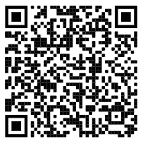
Competitive Cyber Security Organization
General - Web Hacking
By attending today’s meeting you acknowledge that you may be photographed or recorded for club use

Slide 2
Announcements

Slide 3
Learning Objectives:
How websites function
Hacker methodology
Common web attacks

Slide 4
Computer Fraud and Abuse Act (CFAA)
Punishable by up to five years in prison plus fines.
Violations of parts of the CFAA are punishable by 10 years, 20 years, and even life in prison.
What you learn here will not help you avoid time in prison

Slide 5

What is Web? (Requests and responses)
HTTP and HTTPS use requests and responses to communicate
The requests use verbs like GET, PUT, POST, etc.
The responses use status codes from 5 categories
100-199 = informational
200-299 = successful
300-399 = redirect
400-499 = user error
500-599 = server error

Slide 6
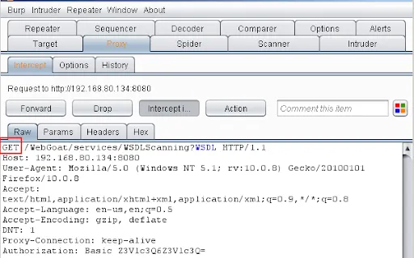
Requests
Request
Header
Message body
Http is the protocol
Html is the web design

Slide 7
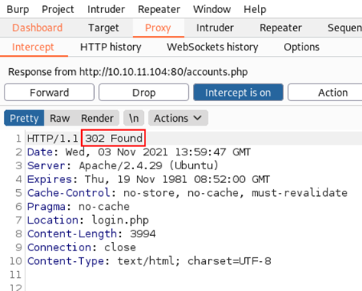
Responses
Status
Header
Body

Slide 8


Proxy
Why do requests and responses matter to us?
Proxies allow us to stand in the middle of that traffic
We can intercept or change what is sent and received
Tools like burpsuite/zap and foxyproxy allow us to do that

Slide 9
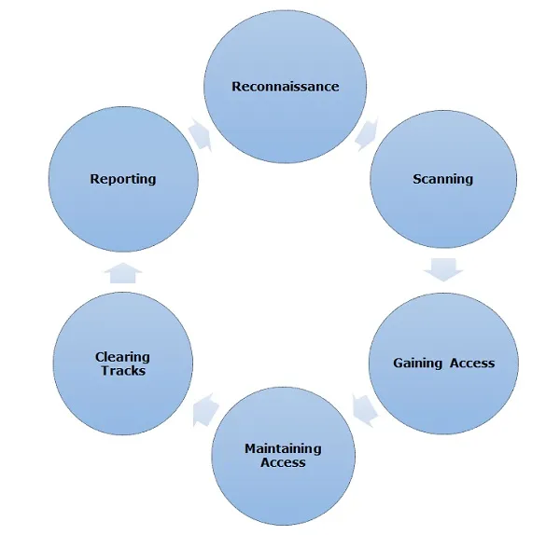
Hacker Methodology

Slide 10
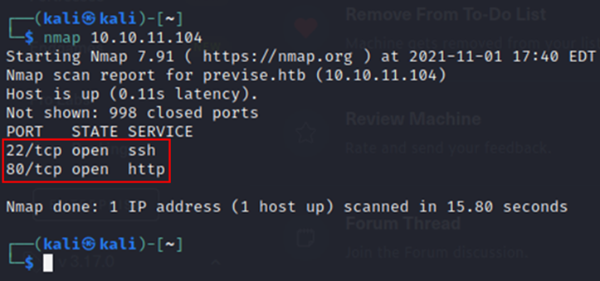
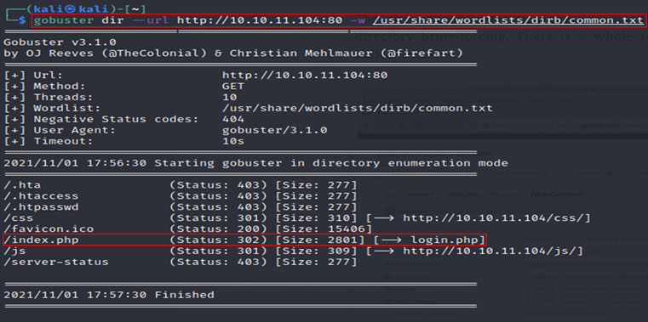
Scanning and fuzzing
nmap: scans networks for open ports
Use flags to beef up output (-sC, -sV, -p-, etc.)
gobuster/feroxbuster: directory scans
Use wordlists to check for open directories.

Slide 11
What to look for
Whatever you can control
Input fields
Hidden values included in request
Anything in the URL
File uploads
Filename
MIME type
Contents
How things are validated
Client side JS or server-side
Helpful errors
Verbose information in source code

Slide 12
Common Web Attacks
SQL injections
SSTI
XSS
Weak credentials
HTTP verb modification

Slide 13
SQL Injection
Many websites utilize databases to store data like user info, encrypted passwords, business info, etc
When websites take in information that interacts with those databases, the info can be manipulated to perform a SQL injection
Malicious SQL code can be inputed to allow an attacker to interfere with how the database interacts with the information it was given
https://portswigger.net/kb/issues/00100200_sql-injection

Slide 14
SQL Injection
The most common sql injection is '+OR+1=1--
This can be injected into an input field or into burpsuite
administrator'-- is another example
Tests can be done with a single quote or other variations of breaking out of SQL syntax

Slide 15
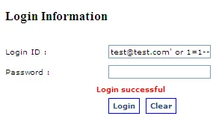
SQL Injection
https://portswigger.net/kb/issues/00100200_sql-injection

Slide 16
SSTI
Server side template injection
Template engines are designed to generate web pages by combining fixed templates with volatile data
When the data includes template directives, code can be ran through the site
Template directives are characters that allow code execution to be ran
https://book.hacktricks.xyz/pentesting-web/ssti-server-side-template-injection

Slide 17
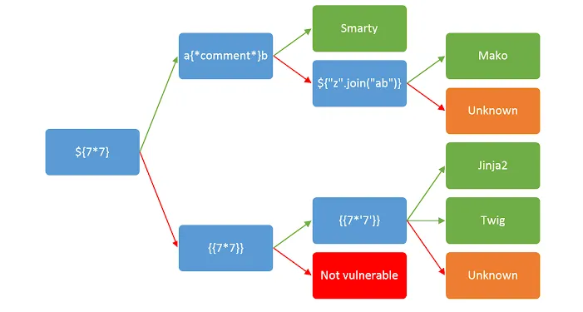
SSTI
https://book.hacktricks.xyz/pentesting-web/ssti-server-side-template-injection

Slide 18
SSTI
Once you verify that a SSTI vulnerability exists, you can use the syntax to inject a payload.
Ex: if <%= 7*7 %> were to work, a payload might look like <&= system (“whoami”) %>

Slide 19
XSS
Cross site scripting
Three types of xss
Reflected xss - comes from http request
Stored xss - comes from web db
DOM-based xss - comes from client-side code

Slide 20
XSS
Reflected xss example:
https://insecure-website.com/status?message=<script>/*+Bad+stuff+here...+*/</script>
Used in url
Stored xss
Test with: <script>alert(“Hello xss”)</script>
Used in an input field
DOM-based xss
You searched for: <img src=1 onerror='/* Bad stuff here... */'>
Usually used in javascript

Slide 21
Default Creds
Default creds are sometimes used on sites with poor configuration
Common examples:
U: admin P: admin
U: Administrator P:
U: admin P: password
If the website is using a specific software, the manual often lists the default creds
This is why reconnaissance and scanning is so important

Slide 22
HTTP Verb Tampering
Utilizing HTTP verbs like GET, PUT, and POST to get around security configurations and upload code.
This is a broad technique that can be used to run other web attacks like sql injections

Slide 23
Web Hacking Takeaways
Websites communicate with requests and responses
Scans can help you gain valuable information about websites
Web attacks can be used to gain initial access on systems

Slide 24
Challenge Setup
Follow along with the README.md from https://github.com/nicobove94/CCSO-DVWA
git clone https://github.com/nicobove94/CCSO-DVWA.git
sudo vim /etc/php/<VERSION>/apache2/php.ini
Check php version with php -v
Edit line ~861 to be allow_url_fopen = On
Edit line ~865 to be allow_url_include = On
sudo apt install php-gd
sudo mv CCSO-DVWA /var/www/html
sudo systemctl enable --now apache2
sudo systemctl enable --now mariadb
Navigate to localhost
cd /var/www/html/CCSO-DVWA; cp config/config.inc.php.dist config/config.inc.php
sudo su

Slide 25
Challenge Setup
mysql
create database ccso;
create user ccso@localhost identified by 'p@ssw0rd';
grant all on ccso.* to ccso@localhost;
flush privileges; exit;
cd /var/www/html/CCSO-DVWA; sudo chgrp www-data hackable/uploads
sudo chgrp www-data /var/www/html/CCSO-DVWA/external/phpids/0.6/IDS/tmp/phpids_log.txt
sudo chmod g+w hackable/uploads
sudo chmod g+w /var/www/html/CCSO-DVWA/external/phpids/0.6/IDS/tmp/phpids_log.txt
Navigate to localhost/CCSO-DVWA/setup.php and press “Create / Reset Database”
Login to the webapp at localhost/CCSO-DVWA/login.php with admin:password

